Slide 1

KVH - 005
Automatic Number Plate Recognition (ANPR) along with Facial Recognition
TEAM MYSTREE
TEAM MEMBERS
MADHAN KUMAR S - 20BEC1112
SWETA T - 20BEC1116
YASWANTH KANNAN G - 20BEC1201
KAVACH 2023

Slide 2
ABSTRACT
Each vehicle has its own identity, the vehicle’s number plate. This identity is observed in unique non-standard ways in different countries. In a diverse country like India, with over 140 Crores population, there is an exponential rise in number of vehicles running on the road. There are many instances of non-standard number plates with different styles, languages, sizes, designs and symbols. This presents a unique challenge for ANPR technology. Differentiating from the existing ANPR and FRS system, this project proposes a methodology which is efficient and advanced. Along with Facial recognition system, this project becomes a powerful tool which can be used for various wide ranging application.
KAVACH 2023

Slide 3
AIM
To Design and develop a technological solution that can accurately perform the Automatic Number Plate Recognition (ANPR) along with Facial Recognition from the available CCTV feeds. The solution should be able to recognize number plates that are written in typical non-standard ways using varying font styles, sizes, designs, symbols, languages etc., i.e. difficult to recognize by existing ANPR Systems.
KAVACH 2023

Slide 4
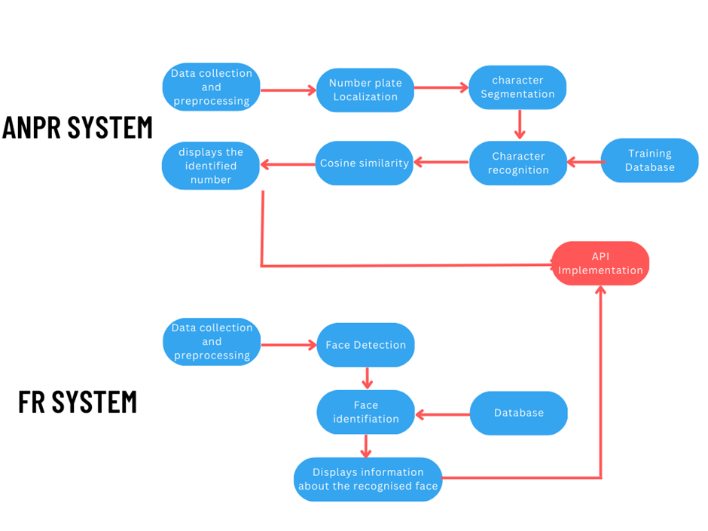
Project Flow
KAVACH 2023

Slide 5
Project Flow
ANPR
FRS
1) Number plate detection
2) Segmentation of plate
3) Character Segmentation
4) Character Detection
1) Facial Detection
2) Face Alignment
3) Feature Extraction
4) Matching
KAVACH 2023

Slide 6
APPROACH
To develop a solution for Automatic Number Plate Recognition (ANPR) along with Facial Recognition, we need to combine several technologies, including computer vision, machine learning, and deep learning.
Collect and pre-process the data: The first step is to collect and preprocess the CCTV feeds
Number plate detection: The next step is to detect the number plates in the CCTV feed. This can be done using object detection techniques such as YOLOv8
Character segmentation: In this step, we need to segment the characters from the number plate ROI
KAVACH 2023

Slide 7
APPROACH
Character recognition: Once the characters are segmented, we can recognize them using Optical Character Recognition (OCR) techniques and Cosine similarity
Facial recognition: Using deep learning algorithms, the model can be trained and tested by initially proceeding with facial detection and then feature extraction
Matching: Comparing with the datasets and available database a match can be found if data is present
Integration: The final step is to integrate the ANPR and Facial Recognition modules to obtain the desired output.
KAVACH 2023

Slide 8
TECHNOLOGY STACK
Processing Units: Powerful processing units are needed to handle the vast amounts of data generated by ANPR and FR systems.
Image processing software: To accurately capture and analyze images, image processing software is essential.
Machine learning algorithms: The success of an ANPR and FR solution depends on the accuracy of its machine learning algorithms, such as Support Vector Machines (SVMs), Convolutional Neural Networks (CNNs), and Deep Learning
Database: A database is required to store and compare recognized number plates and faces against stored data for identification and authentication purposes
KAVACH 2023

Slide 9
SOFTWARES USED
YoloV8
OpenCV
EasyOCR
Google Collab
Visual Studio code
PyTorch
KAVACH 2023

Slide 10
USE CASES
Stolen vehicle tracking
Facial Identification
Driver identification along with number plate recognition
When integrated with CCTV crime detection, a powerful tool in post-crime detection
KAVACH 2023

Slide 11
SHOWSTOPPER
CCTV footage dataset
Character matching datasets for various fonts
GPU Configuration
Character matching datasets for various languages
Facial database
KAVACH 2023

Slide 12
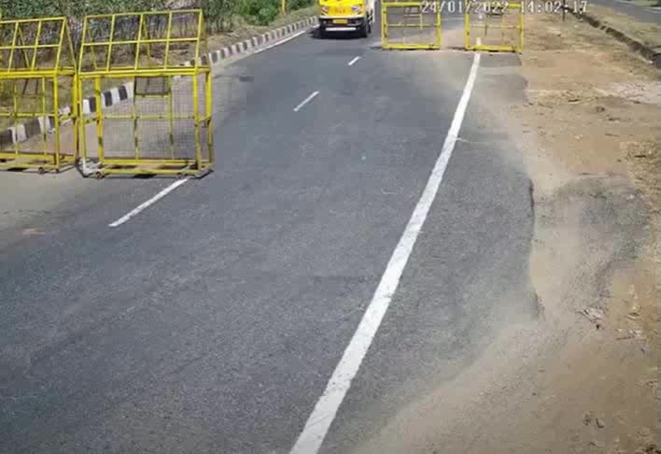
OUTPUTS - License Plate Detection
KAVACH 2023

Slide 13
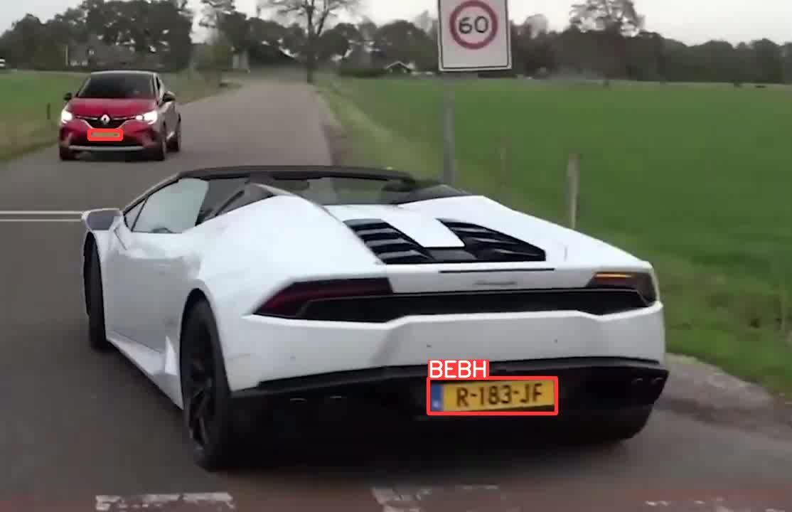
OUTPUTS - License plate character recognition
KAVACH 2023

Slide 14
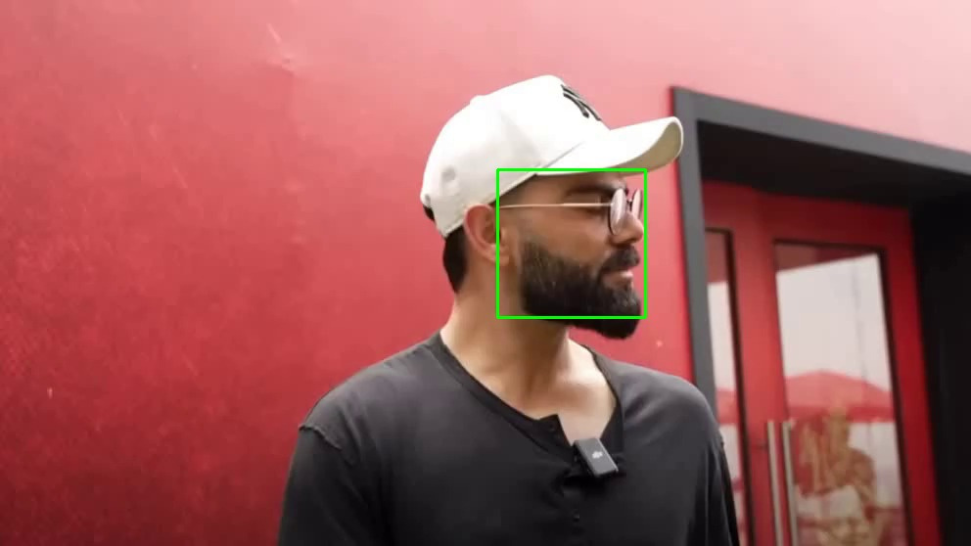
OUTPUTS - Face recognition
KAVACH 2023

Slide 15
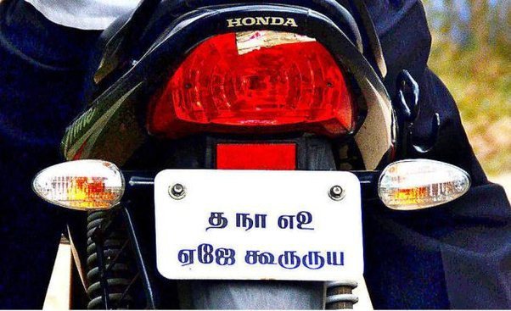
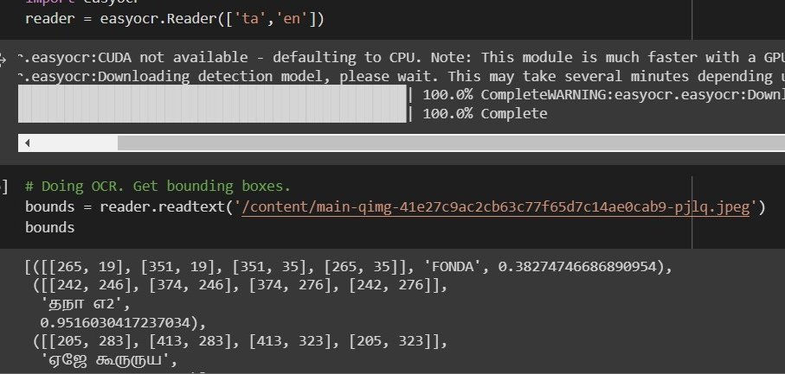
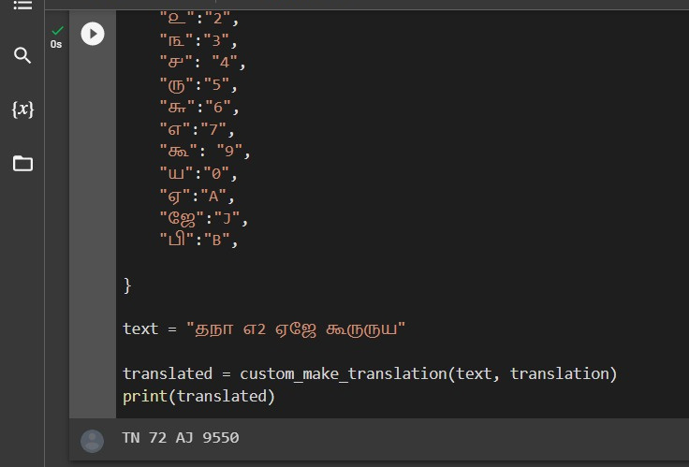
OUTPUTS - Non-standard plate recognition
A non-standard plate
Plate recognised
Plate translated
KAVACH 2023

Slide 16
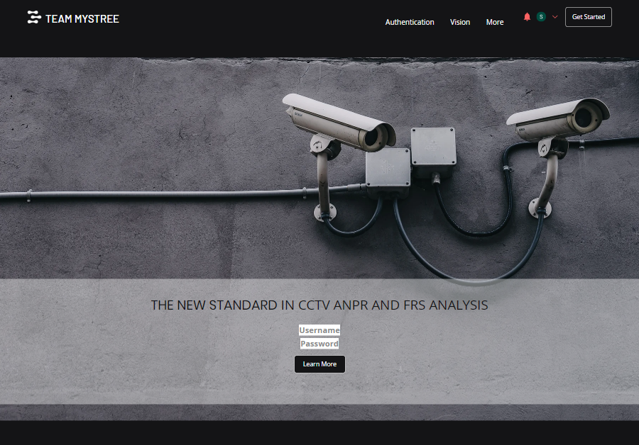
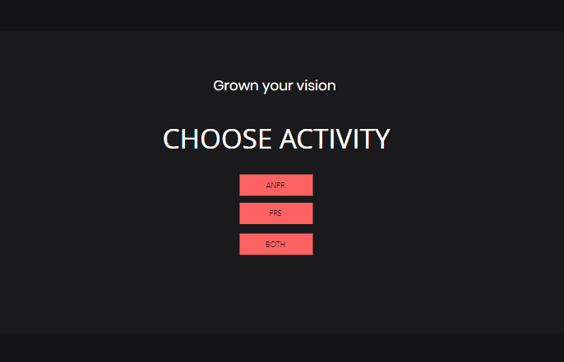
OUTPUTS - Front end website of the basic proposed system
KAVACH 2023

Slide 17
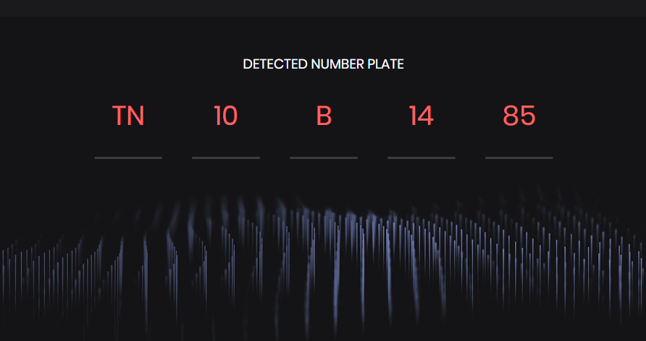
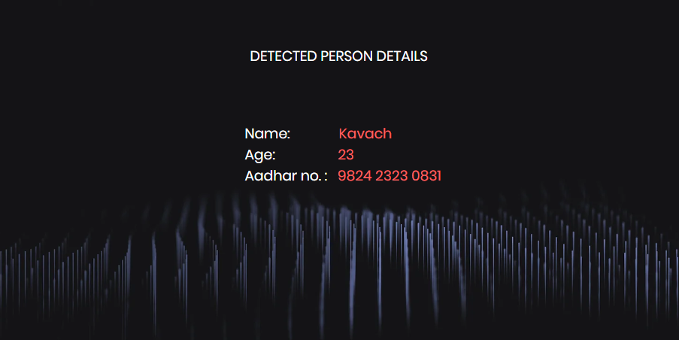
OUTPUTS
KAVACH 2023

Slide 18
Thank you !

